Slide 1

USSF SSTI2
UNCLASSIFIED
Development of Advanced Space Robotics Technologies to Enable
Challenging In-Space Operations for ISAM and Space Logistics
PI: Ou Ma, Alan Shepard Chair Professor, University of Cincinnati, maou@ucmail.uc.edu
Co-PIs/Co-Is: Kelly Cohen, Donghoon Kim, Ian Walker, Eric Butcher, Rajnikant Sharma, Gordon Roesler, Phil Putman, Gardell Gefke, and Kenneth Ruble
Notes:
PI = Primary Investigator (lead)
The best person to lead this discussion is someone comfortable with public speaking, with a technical background to be able to answer most questions. It is recommended to either have a SME coach them or be present to answer the most detailed questions from the audience if the presenter runs into issues.
Think of this as a “TED Talk” – an example is here: https://youtu.be/qp0HIF3SfI4?si=j7xDW0I-i5s6WQGp
Title of the briefing should be for a general audience and not something only a SME will understand. Slide 4 is where you can get into the details of your technical approach and research goals.
DO NOT use this time to pitch your university and all offerings under it. This should be focused on a specific effort that you consider the most cutting-edge and interesting to the space community.

Slide 2






USSF SSTI2
Research Overview and Team Introduction
Project Overview
Developing robotic servicing systems, enabling technologies and operations concepts that will support improvement across a range of logistics and servicing capabilities. – USSF Press Release, April 10, 2024
Key research areas: multi-robot/vehicle cooperation, contact dynamics and control, hardware-in-the-loop simulation, soft robotics, CubeSat GNC, machine learning & explainable AI, servicing noncooperative objects.
Notes:
For this slide, please focus on the one or a related cluster of your most interesting research. First – be sure to discuss “WHY” are you doing this research? What problem are you trying to solve and why does this research matter? What is potential impact to future space technology?
The intention is to get into some of the technical details or concepts that it’s based on. Also discuss any progress made in the last year.
This is where you can get technical, but please remember that most people in attendance are either technical experts in another area or not technical experts at all. Be sure to discuss explanations or have a quick overview (that you can talk to, not on the slide) of the details related to the technical goals.
If you have technical goals for your research, please list it here.
This is intended to be briefed to a combined audience of academics, government personnel and some industry space representatives. Brief something related – or able to be related – to space. Ideally, something to cause them to want to partner with you.

Slide 3
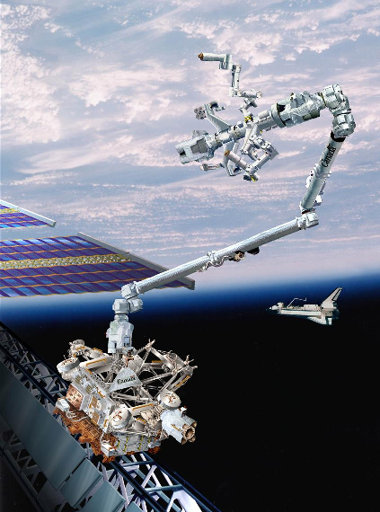
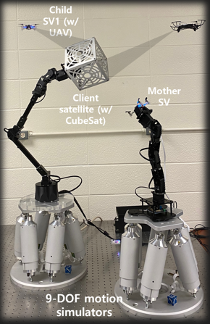
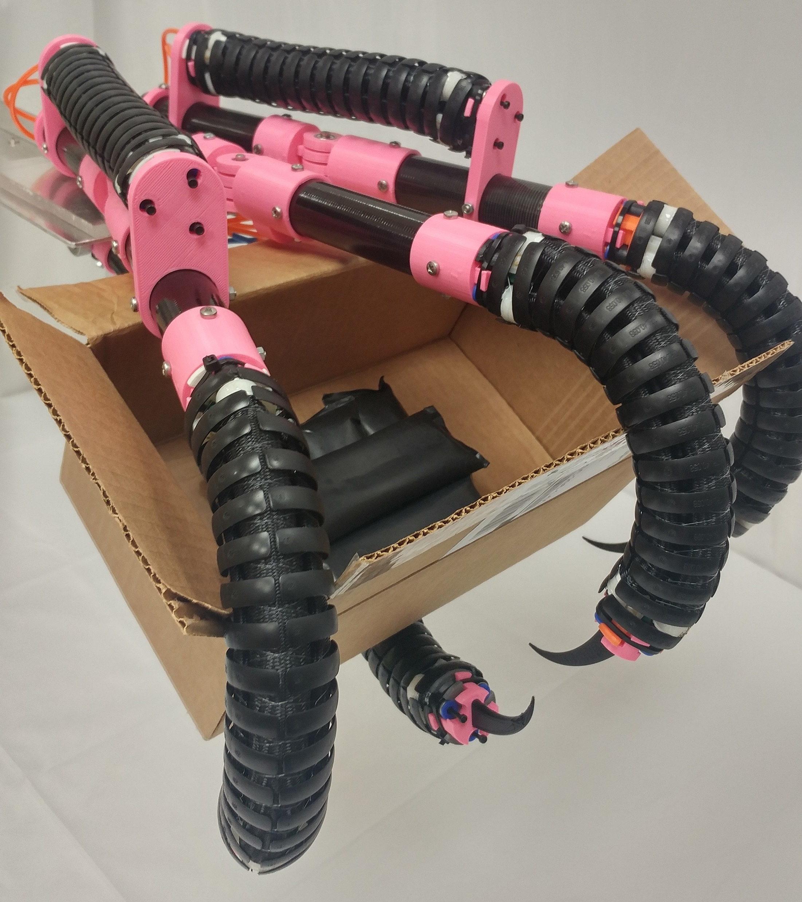
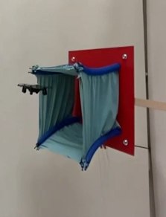
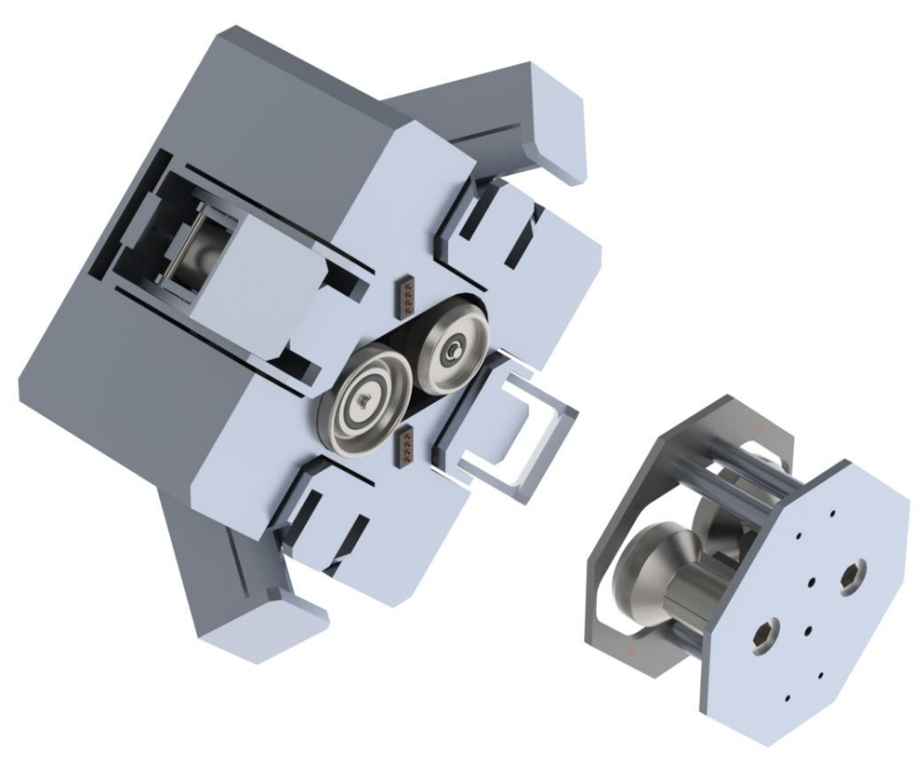
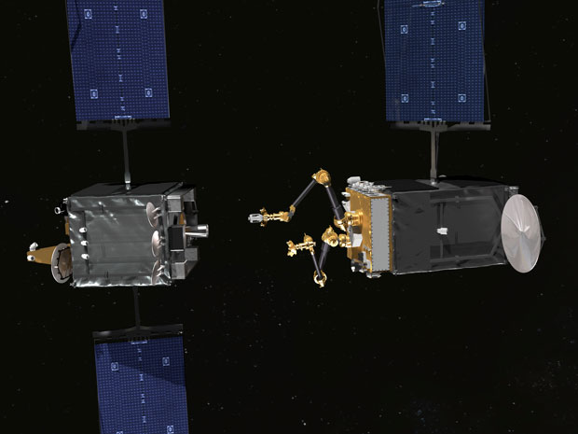
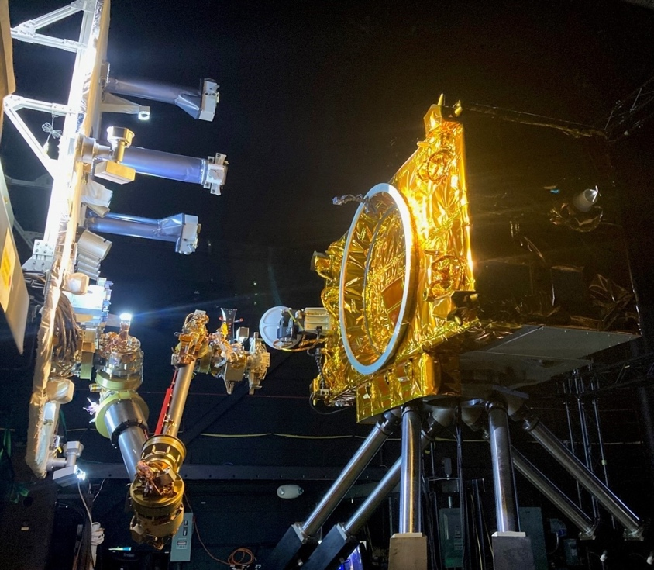
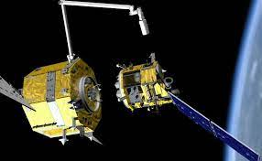
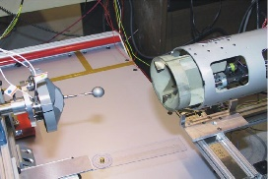

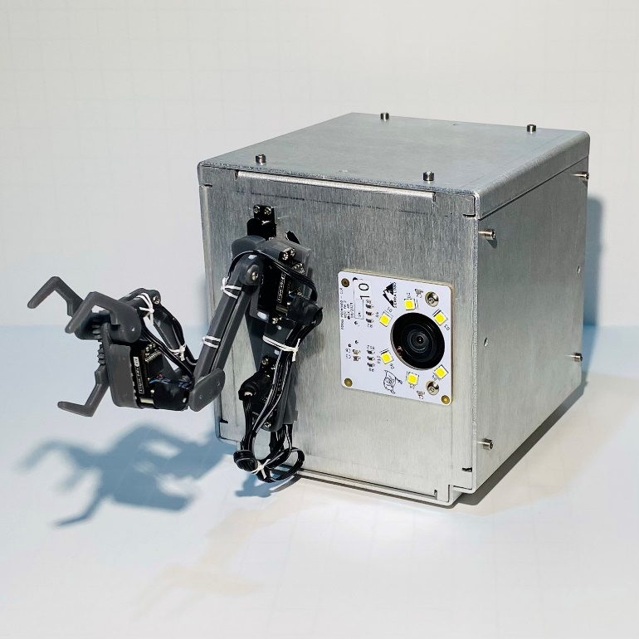
USSF SSTI2
Team Introduction
(Key members and their most relevant experiences)
Dr. Ou Ma, Univ of Cincinnati
maou@ucmail.uc.edu, (513)556-3747
Dr. Donghoon Kim, Univ of Cincinnati
kim3dn@ucmail.uc.edu, (513)556-5365
Dr. Ian Walker, Clemson University
iwalker@clemson.edu, (864)656-7209
Dr. Eric Butcher, University of Arizona
ebutcher@arizona.edu, (864)656-7209
Dr. Raj Sharma, AFIT
rajnikant.sharma@us.af.mil
Formation flight with attitude synchronization
SPDM
(DEXTRE)
SSRMS
(Canadarm2)
Soft robotic grippers
Dr. Phil Putman, Sierra Lobo Inc.
pputman@sierralobo.com, (567)401-1064
Soft robotic grippers
Dr. Gordon Roesler, Robot in Space
robotsinspacellc@gmail.com, (571)214-6312
Mr. Gardell Gefke, Vehicle System Integration
gardell.gefke@vsi.aero, (301)513-0115
ISS
NASA OSAM-1
Dr. Kelly Cohen, Univ of Cincinnati
cohenky@uc.edu, (513)766-6586
RAFTI refueling mechanism
DARPA RSGS
Orbital Express arm
Explainable AI & run time assurance
CubeSat with a mini arm to be launched by NASA in 2025
Notes:
This slide is intended to do two things:
Introduce significant members of your team and tell us a little about yourselves.
Serve as a kind of “business card” for everyone else at the conference so they can contact you if they’re interested in what you present.

Slide 4
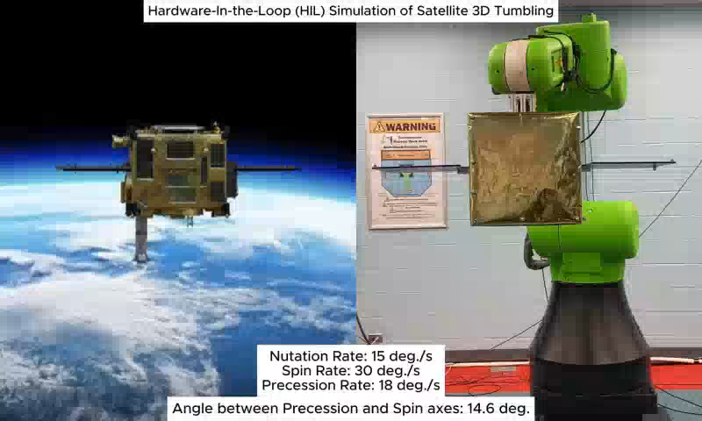
USSF SSTI2
University of Cincinnati
Intelligent Robotics and Autonomous System Lab, 513-556-3684
Technology (funded by AFOSR DURIP)
Unique method of physically rendering accurate and fully controllable 3D tumbling (3-axis rotation) motion.
Hardware-in-the-loop (real-time) dynamic simulation
Method to test multi-robot/spacecraft dynamic behavior for team co-operation for RPO tasks.
Benefits
Allows to test RPO operations around a noncooperative client in a fully-controlled and repeatable environment, which are otherwise difficult to do with ground-based facilities.
Allows to view and test dynamic behavior of swarm operations.
Allows to test real sensors and other hardware in an integrated system as they are operated in orbit.
Notes:
This slide is intended to do two things:
Introduce significant members of your team and tell us a little about yourselves.
Serve as a kind of “business card” for everyone else at the conference so they can contact you if they’re interested in what you present.

Slide 5
Project Deliverables (TRL#, Dates)
rajnikant.sharma@us.af.mil>
USSF SSTI2
Concepts of novel robotic servicing system and anticipated use cases (2025)
Feasibility study of the use cases including ConOps and driving requirements (TRL3, 2026)
Hardware-in-the-loop simulation-based testbed for testing challenging operations (TRL4, 2027)
New enabling robotic technologies for operations of the proposed servicing system (TRL4/5, 2025-2028)
Lab-based demonstrations and datasets from studying the new technologies (TRL4/5, 2028-2029)
Designs and software for transition to AFRL and industry (TRL4/5, 2028-2029)
Trained students in all degree levels
Notes:
Related to the previous slide of scientific/technological project/cluster of related projects, what do you expect will be delivered from those at the conclusion? Paper? Study? Software? Hardware? Prototype?
There can be several deliverables, depending on the project(s), but they should be summarized on this slide. If there are too many to fit, recommend just highlighting the latest-TRL or most interesting ones.
Like the prior slide, this will be briefed in front of an audience of academics, government, and some industrial representatives. What sort of things will catch their eye and (ideally) lead to future partnerships or development?
Finish presentation with some highlight, “In this effort, the next partnership/assistance/transition we’re looking for is…” (i.e. – “Setting up a research sharing agreement with AFRL SMEs”, “Seeking funding via SURI, the UC, etc…”, or “transitioning this to a company, etc…”, “Seeking money for prototypes…”)

